Slide 1


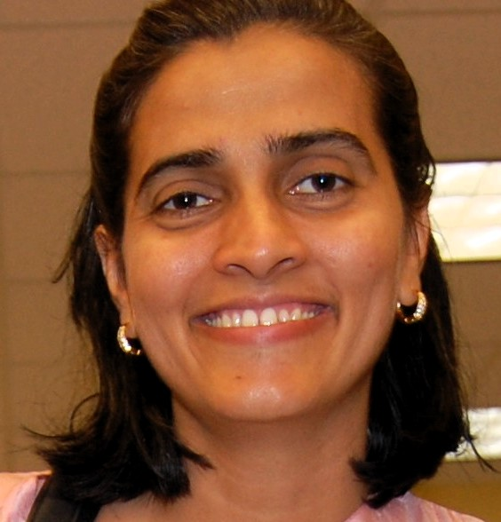


SECRETS FOR APPROACHING BARE-METAL PERFORMANCE WITH REAL-TIME NFV
Suyash Karmarkar
Principal Software Engineer
Souvik Dey
Principal Software Engineer
Anita Tragler
Product Manager Networking & NFV
OpenStack Summit - Sydney, Nov 6th 2017
Notes:
Speaker Intro:
Suyash Intro<>
Souvik Intro <>
Anita Intro<>
Sonus and genband after merger are now Ribbon communications.
Why are we here:
In this presentation we Redhat and Sonus Networks are here to to talk about the advanced performance tuning configurations in both the OpenStack host and guest VM to achieve maximum performance and also share the learnings and best practices from the real world NFV Telco cloud deployments.

Slide 2
Agenda
What is an SBC?
SBC RT application description
Performance testing of SBC NFV
NFV cloud requirements
Performance Bottlenecks
Performance Gains by tuning
Guest level tunings
Openstack Tunings to address Bottlenecks (CPU, Memory)
Networking choices : Enterprise workloads /Carrier workloads
Virtio
SR-IOV
OVS-DPDK
Future/Roadmap Items

Slide 3
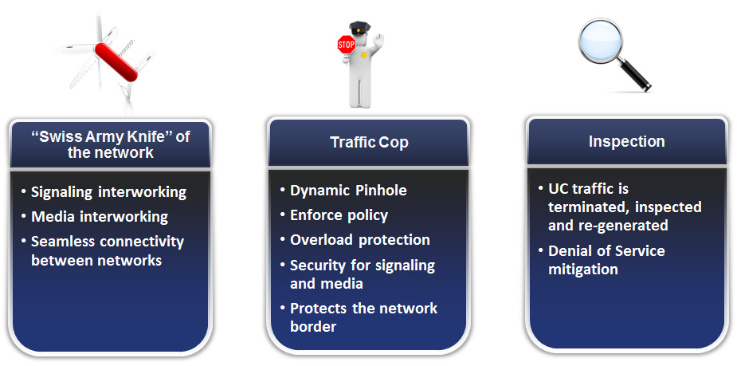
What is a SBC : Session Border Controller?

Slide 4
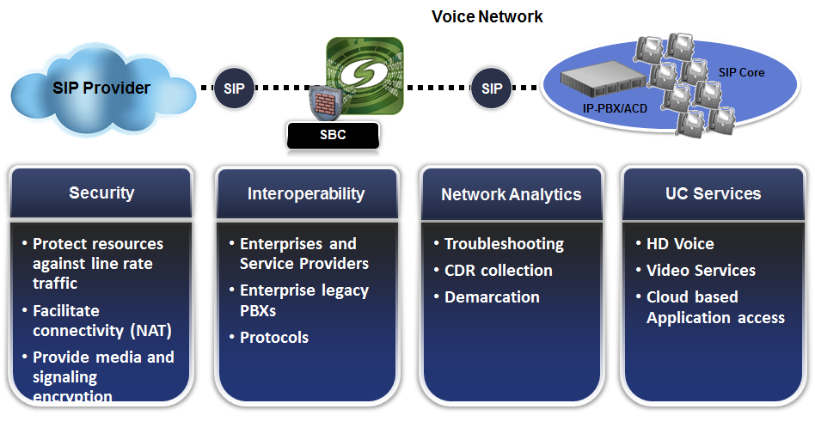
SBC is - Compute, Network and I/O Intensive NFV
SBC sits at the Border of Networks and acts as an Interworking Element, Demarcation point, Centralized Routing database, Firewall and Traffic Cop

Slide 5
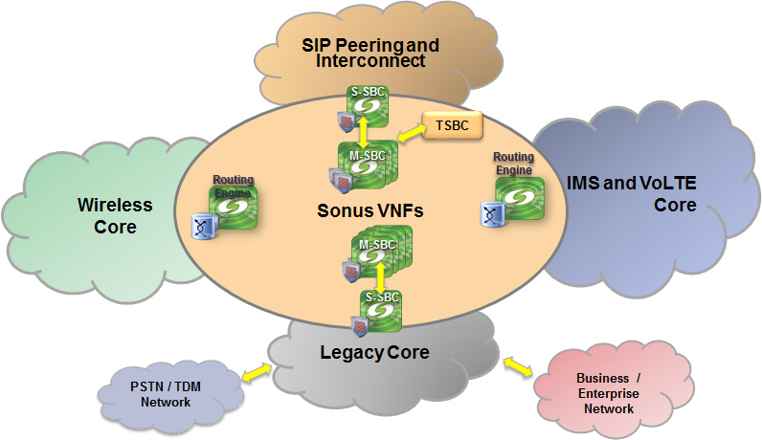
SBC NFV : Use Case in Cloud Peering and Interworking
Multiple complex call flows
Multiple protocol interworking
Transcoding and Transrating of codecs
Encryption & security of Signaling and media
Call recording and Lawful Interception
Notes:
PSX to routing Engine
MRF replace with TSBC

Slide 6
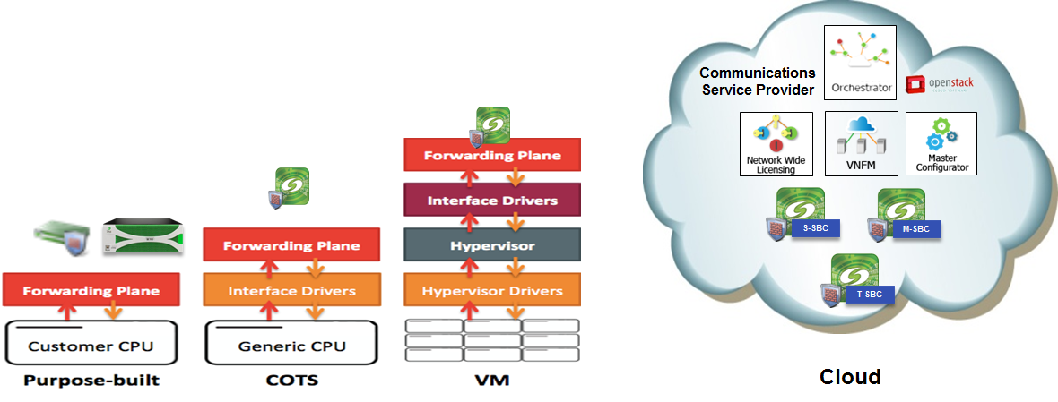
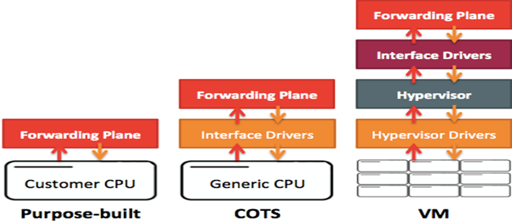
Evolution of SBC
Custom H/W to a NFV appliance
Notes:
Network
Evolving by becoming commoditized and programmable
Data center and Software Defined networks
Traffic pattern
Evolving from an audio centric session to a multi-media session
No Vendor Lock-down with Custom H/W
Moving from a custom hardware to a virtualized(COTS server) to cloud environment.
Customers building large data center to support Horizontal & Vertical Scaling.

Slide 7
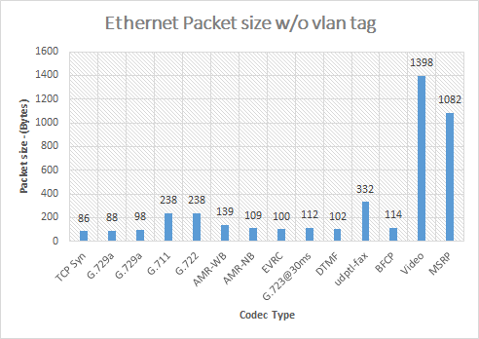
Unique Network Traffic Packet Size

Slide 8
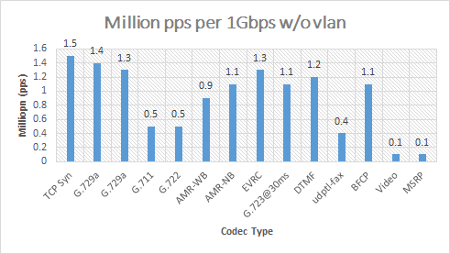
PPS Support Required by Telco NFV
IFG | 12 | Stripped on wire
Preamble | 8
Ethernet Header | 14 | 64
IP Header | 20
Transport | 8
Packet Payload | 18
CRC | 4
 | 84
Maximum MPPS |  | 1.5

Slide 9
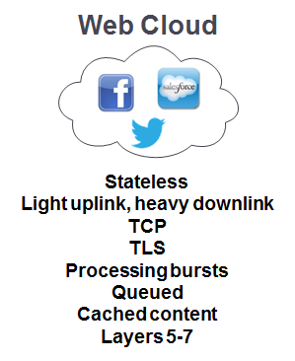
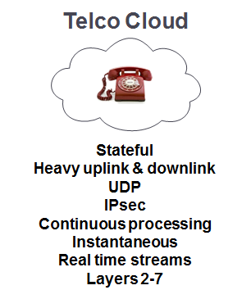

Telco Real Time NFV Requirements vs Web Cloud
Commercial Virtualization Technologies Were not Not Made for RTC
Notes:
downlink -> what we receive (packets) -> web ( downlink) -> writing is more , reading is less.
Transmit -> uplink
UDP/SRTP

Slide 10
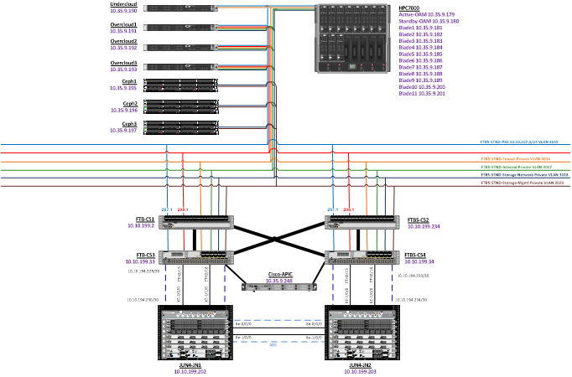
Performance tests of SBC NFV
Redhat Openstack 10 cloud with controllers and redundant ceph storage
Compute on Which the SBC NFV is hosted
Test Equipment to Pump calls
Notes:
discuss iperf benchmarking vs Real time NFV Benchmarking

Slide 11
Performance Requirements of an SBC NFV
Guarantee Ensure application response time.
Low Latency and Jitter Pre-defined constraints dictate throughput and capacity for a given VM configuration.
Deterministic RTC demands predictive performance.
Optimized Tuning OpenStack parameters to reduce latency has positive impact on throughput and capacity.
Packet Loss Zero Packet Loss so the quality of RT traffic is maintained.
Notes:
Cover High Availability and removed optimized.
carrier grade 5-9’s requirement

Slide 12
Performance Bottlenecks in Openstack
The Major Attributes which Govern Performance and Deterministic behavior
CPU - Sharing with variable VNF loads The Virtual CPU in the Guest VM runs as Qemu threads on the Compute Host which are treated as normal processes in the Host. This threads can be scheduled in any physical core which increases cache misses hampering performance. Features like CPU pinning helps in reducing the hit.
Memory - Small Memory Pages coming from different sockets The virtual memory can get allocated from any NUMA node, and in cases where the memory and the cpu/nic is from different NUMA, the data needs to traverse the QPI links increasing I/O latency. Also TLB misses due to small kernel memory page sizes increases Hypervisor overhead. NUMA Awareness and Hugepages helps in minimizing the effects
Network - Throughput and Latency for small packets The network traffic coming into the Compute Host physical NICs needs to be copied to the tap devices by the emulator threads which is passed to the guest. This increases network latency and induces packet drops. Introduction of SR-IOV and OVS-DPDK helps the cause.
Hypervisor/BIOS Settings - Overhead, eliminate interrupts, prevent preemption Any interrupts raised by the Guest to the host results in VM entry and exit calls increasing the overhead of the hypervisor. Host OS tuning helps in reducing the overhead.
Notes:
Secure IOMMU and KSM .

Slide 13
Performance tuning for VNF(Guest)
Isolate cores for Fast Path Traffic, Slow Path Traffic and OAM.
Use of Poll Mode Drivers for Network Traffic
DPDK
PF-RING
Use HugePages for DPDK Threads
Do Proper Sizing of VNF Based on WorkLoad.
Notes:
Core segregation of network/signaling/oAM
Workload - network (virtio, etc)

Slide 14
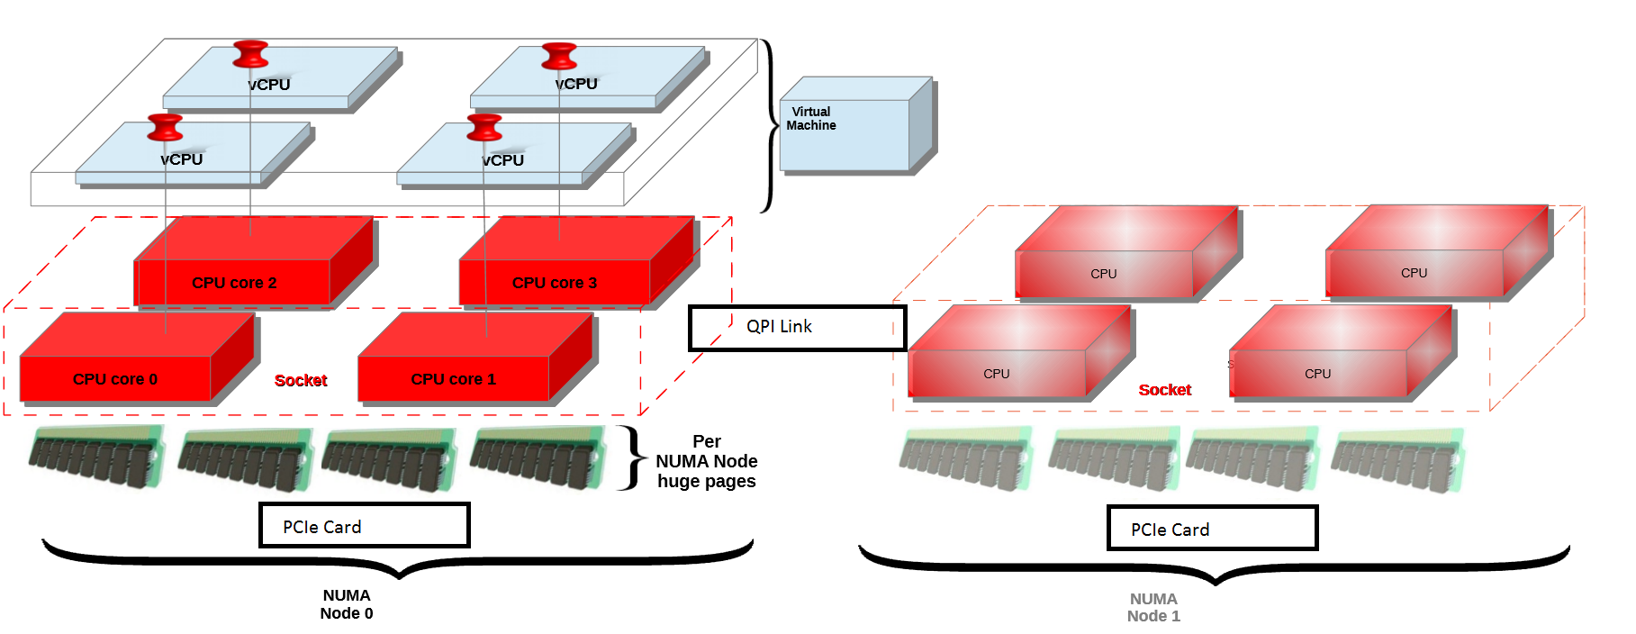
Ways to Increase Performance
CPU , NUMA , I/O Pinning and Topology Awareness

Slide 15
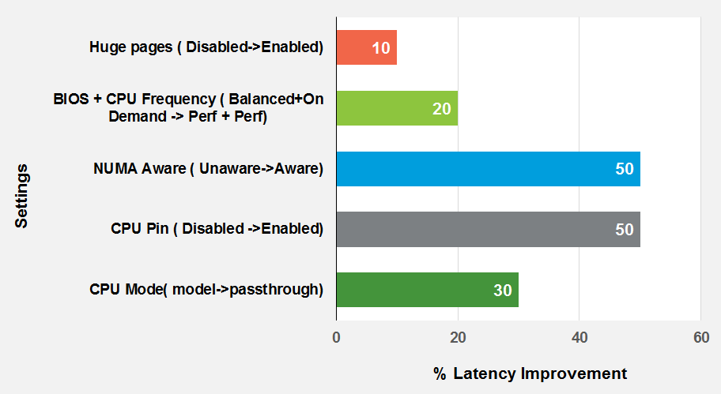
PERFORMANCE GAIN WITH CONFIG CHANGES and Optimized NFV
Notes:
communicate this clearly that SBC NFV optimized with this settings gives the maximum performance.

Slide 16
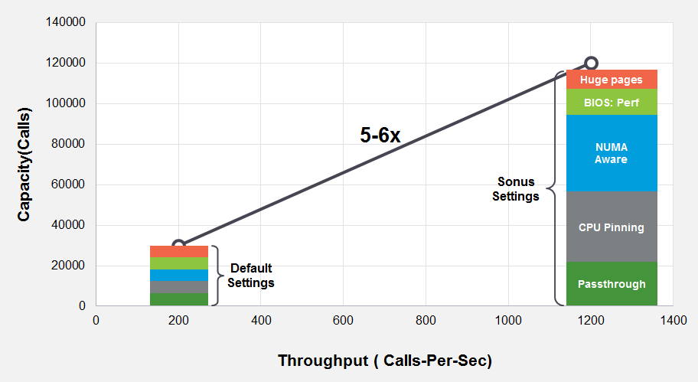
PERFORMANCE GAIN WITH CONFIG CHANGES and Optimized NFV
Notes:
Update.

Slide 17
Performance tuning for CPU
Enable CPU Pinning
Exposes CPU instruction set extensions to the Nova scheduler
Configure libvirt to expose the host CPU features to the guest
Enable ComputeFilter Nova scheduler filter
Remove CPU OverCommit
CPU Topology of the Guest
Segregate real-time and non real-time workloads to different computes using host aggregates
Isolate Host processes from running on pinned CPU
Notes:
Cpu pinning - vcpu_pin_set in nova.conf
hw:cpu_threads_policy=avoid|separate|isolate|prefer
hw:cpu_policy=shared|dedicated
host-model host-pasthrough cpu_mode in nova.conf
virt_type= kvm
topology through flavor extra hw flags cpu_socket,cpu_cores,cpu_threads

Slide 18
Performance tuning for Memory
NUMA Awareness
The key factors driving usage of NUMA are memory bandwidth, efficient cache usage, and locality of PCIe I/O devices.
Hugepages
The allocation of hugepages reduces the requirement of page allocation at runtime depending on the memory usage. Overall it reduces the hypervisor overhead. The VMs can get the RAM allocated from this THP to boost their performances.
Extend Nova scheduler with the NUMA topology filter
Remove Memory OverCommit
Notes:
hw:numa_nodes hw:numa_mempolicy=strict|preferred hw:numa_cpus.NN hw:numa_mem.NN
hw:mem_page_size=small|large|any|2048|1048576

Slide 19
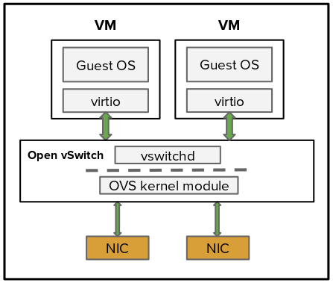
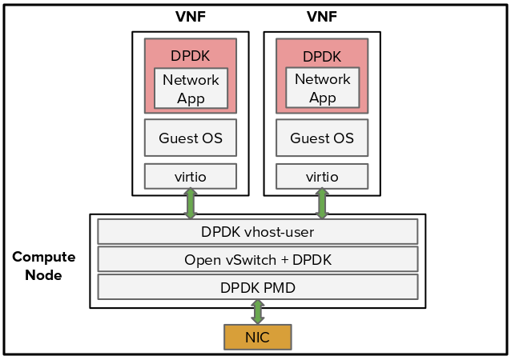
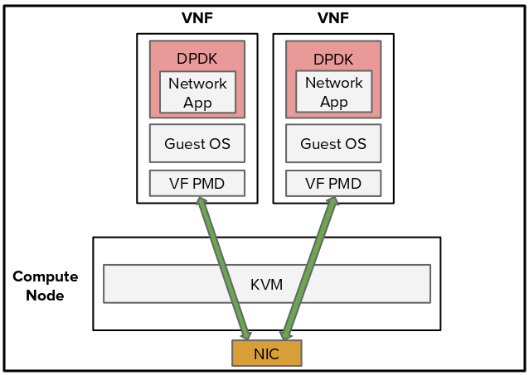
Network - Datapath options in OpenStack
VNF with Open vswitch (kernel datapath)
VNF with OVS-DPDK
(DPDK datapath)
VNF with SR-IOV
Single-Root IO Virtualization
User space
Kernel space
PF1
PF2
Notes:
Anita - virtio, sriov, ovs-dpdk

Slide 20
Networking - Datapath Performance range
Measured in Packets per second with 64 Byte packet size
Low Range
Kernel OVS
Mid Range
OVS-DPDK
High Range
SR-IOV
No Tuning, default deployment
Up to 50 Kpps
Up to 4 Mpps per socket*
*Lack of NUMA Awareness
21+ Mpps per core (Bare metal)
[Improved NUMA Awareness in Pike]
Notes:
Anita- Example of Deployments.

Slide 21

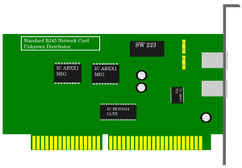
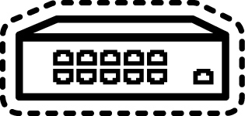
Typical SR-IOV NFV deployment
VNF mgmt and
OpenStack APIs & tenant
Provisioning
DHCP+PXE
compute node
regular NICs
regular NICs
OVS bridges
Data-plane VNFc
OVS with Virtio interface for management (VNF signalling, Openstack API, tenant)
DPDK application in VM on VFs
Network redundancy (HA)
Bonding in the VMs
Physical NICs (PF) connected to different ToR switches
VNFc0
mgt
mgt
kernel
VNFc1
kernel
DPDK
DPDK
bond bond bond bond
VF0
VF1
VF2
VF3
VF0
VF1
VF2
VF3
SR-IOV
PF0 PF1 PF2 PF3
fabric 0
(provider network)
fabric 1
(provider network)
Notes:
Anita

Slide 22

VNF with SR-IOV: DPDK inside!
VNF Guest: 5 vCPUs
Host
ssh, SNMP, ...
VF DPDK PMD
eth0
user land
kernel
ACTIVE LOOP
while (1) {
RX-packet()
forward-packet()
}
virtio driver
CPU0 CPU1 CPU2 CPU3 CPU4
RX TX
RX TX
RX TX
RX TX
RX TX
user land
kernel
OVS
VF or PF multi-queues
SR-IOV
Notes:
DPDK is about busy polling, active loop
DPDK is used in the hypervisor => OVS-DPDK for physical NICs and vhost-user ports polling
DPDK is used in the guest => legacy dataplane applications have been ported on DPDK, first natively, and now on virtIO PMD
We have many active loops (DPDK) and we have to make sure to have only one active loop per CPU, next slides will explains how

Slide 23
SR-IOV- Host/VNFs guests resources partitioning
Typical 18 cores per node dual socket compute node (E5-2599 v3)
All host IRQs routed on host cores: the first core of each NUMA node will receive IRQs, per HW design
All VNFx cores dedicated to VNFs
Isolation from others VNFs
Isolation from the host
Virtualization/SR-IOV overhead is null and the VNF is not preempted.
Bare-metal performance possible - Performances ranges from 21 Mpps/core to 36 Mpps/core
Qemu emulator thread needs to be re-pinned!
one core, 2 hyperthreads
mgt
VNFc0
VNFc2
Host
VNFc1
SR-IOV
SR-IOV
NUMA node0
NUMA node1

Slide 24
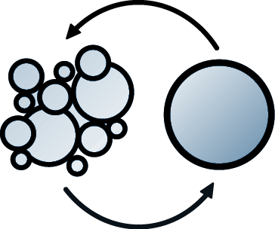
Emulator (QEMU) thread pinning
Pike
12
Pike Blueprint, refinement debated for Queens
The need (pCPU: physical CPU; vCPU: virtual CPU)
NFV VNFs require dedicated pCPUs for vCPUs to guarantee zero packet loss
Real-time applications requires dedicated pCPUs for vCPUs to guarantee Latency/SLAs
The issue: the QEMU emulator thread run on the hypervisor and can preempt the vCPUs
By default, the emulator thread run on the same pCPUs as the vCPUs
The solution: make sure that the emulator thread run on different pCPU than the vCPUs allocated to VMs
With Pike, the emulator thread can have a dedicated pCPU: good for isolation & RT
With Queens?, the emulator thread can compete with specific vCPUs
Will avoid to dedicate a pCPU when not neede
emulator thread on vCPU 0 of any VNF, as this vCPU is not involved in packet processing

Slide 25
SR-IOV NUMA awareness - Non PCI VNF Reserve (PCI weigher)
Pike
12
VMs scheduled regardless of their SR-IOV needs
VNFc3:
requires SR-IOV
VMs scheduled based on their SR-IOV needs:
Blueprint reserve NUMA with PCI
Cannot boot VNFc3: node0 full!
NUMA node0
NUMA node1
NUMA node0
NUMA node1
VNFc0:
requires SR-IOV
VNFc1:
do not requires SR-IOV
VNFc2:
do not requires SR-IOV
VNFc0:
requires SR-IOV
VNFc3:
requires SR-IOV
VNFc1:
do not requires SR-IOV
VNFc2:
do not requires SR-IOV
SR-IOV
SR-IOV
Notes:
Schedule VMs (VNFc) according to their need of SR-IOV devices: before this enhancement, VMs were scheduled regardless of their SR-IOV needs

Slide 26

OpenStack and OVS-DPDK
OpenStack APIs
Provisioning
DHCP+PXE
VNFs ported to VirtIO with DPDK accelerated vswitch
DPDK in the VM
Bonding for HA done by OVS-DPDK
Data ports need performance tuning
Management and tenant ports - Tunneling (VXLAN) for East-West traffic
Live Migration <=500ms downtime
compute node
regular NICs
regular NICs
bonded
VNF0
VNF1
DPDK
kernel
DPDK
kernel
eth0
eth1
mgt
eth0
eth1
mgt
OVS+DPDK bridges
DPDK NICs
bonded
bonded
bonded
DPDK NICs
DPDK NICs
VNFs mgt
& tenant network
fabric 0
(provider network)
fabric 1
(provider network)

Slide 27
OpenStack OVS-DPDK
Host/VNFs guests resources partitioning
Typical 18 cores per node dual socket compute node (E5-2599 v3)
All host IRQs routed on host cores
All VNF(x) cores dedicated to VNF(x)
Isolation from others VNFs
Isolation from the host
HT provide 30% higher performance
1 PMD thread (vCPU or HT) per port (or per queue)
OVS-DPDK not NUMA aware - Cross NUMA affects performance by ~50%
a VNF should fit on a single NUMA node
A VNF has to use the local DPDK NICs
one core, 2 hyperthreads
mgt
OVS-DPDK
PMDs[1]
VNF0
VNF3
Host
VNF1
NUMA node0
NUMA node1

Slide 28
OVS-DPDK NUMA aware scheduling
Design discussion in progress upstream
Compute node
NUMA node0
NUMA node1
Nova does not have visibility into DPDK data port NICs
Neutron needs to provide info to Nova so that VNF (VCPUs, PMD threads) can be assigned to the right NUMA node.
VNF1 control
VM
VNF data
VM
RX TX
RX TX
vhost-user
OVS-DPDK
RX TX
RX TX
DPDK data ports

Slide 29
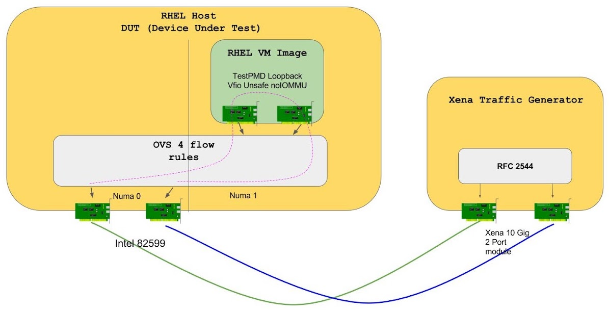
OVS-DPDK on RHEL performances: NUMA
OpenFlow pipeline is not representative for OpenStack (simplistic 4 rules)
OVS 2.7 and DPDK 16.11, RHEL 7.4, Intel 82599ES 10G
64 Bytes | Cross Numa (pps) | Same Numa (pps)
2 PMDs/1core | 2,584,866 | 4,791,550
4 PMDs/2 cores | 4,916,006 | 8,043,502
1500 bytes | Cross Numa (pps) | Same Numa (pps)
2 PMDs/1core | 1,264,250 | 1,644,736
4 PMDs/2 cores | 1,636,512 | 1,644,736
Notes:
RFC2544 120 second trials 20 minute verify
RPMs Used
dpdk-tools-16.11-5.el7fdb.x86_64.rpm
dpdk-16.11-5.el7fdb.x86_64.rpm
openvswitch-2.7.2-1.git20170719.el7fdp.x86_64
qemu-kvm-rhev-2.6.0-28.el7_3.9.x86_64
qemu-kvm-common-rhev-2.6.0-28.el7_3.9.x86_64
ipxe-roms-qemu-20160127-5.git6366fa7a.el7.noarch
qemu-img-rhev-2.6.0-28.el7_3.9.x86_64
tuned-2.8.0-2.el7fdp.noarch.rpm
tuned-profiles-cpu-partitioning-2.8.0-2.el7fdp.noarch.rpm
Host Info
* OS: redhat 7.4 Maipo
* Kernel Version: 3.10.0-693.el7.x86_64
* NIC(s):
* Intel Corporation 82599ES 10-Gigabit SFI/SFP+ Network Connection (rev 01)
* Intel Corporation 82599ES 10-Gigabit SFI/SFP+ Network Connection (rev 01)
* Board: Dell Inc. 072T6D [2 sockets]
* CPU: Intel(R) Xeon(R) CPU E5-2650 v4 @ 2.20GHz
* CPU cores: 48
* Memory: 131811836 kB
Guest Info
* OS: redhat 7.4 Maipo
* Kernel Version: 3.10.0-693.el7.x86_64
CPU-partitioning profile
dpdk 17.05

Slide 30
Multi-queue: Flow steering/RSS between queues
Flow is identified by NIC or OVS as 5-tuple (IP, MAC, VLAN, TCP/UDP port)
Most NICs support flow steering with RSS (receive side scaling)
One CPU[*] per queue (no lock => perf), avoid multiple queues per CPU[*] unless unused or lightly loaded queues
*CPU: one hyperthread
1 given flow always directed to the same queue (packet ordering)
/!\ Flow balancing == workload balancing…
/!\ true for unbalancing as well!
Queue0/CPU-X
Flow 1
Flow 2
Flow 2
Flow 3
Flow 1
Flow 2
Flow 2
Flow 1
Queue1/CPU-Y
Flow 3
Flow 4
Incoming packet, belonging to different flows
Steering algorithm per NIC
Flow definition per NIC
QueueN/CPU-Z

Slide 31
OVS-DPDK Multi-Queue - Not all queues are equal
Goal: spread equally the load among PMDs
“All PMD threads (vCPUs) are equal”
NIC Multi-queue with RSS
“All NICs are equal”
“All NICs deserve the same PMD number”
1 PMD thread (vCPU or HT) per queue per port
Traffic may not be balanced
Depends on number of flows and load per flow
Worse case: active/backup bond
Rebalancing queues based on load [ OVS work in progress]
VNF0
Host
4 PMD threads (2 cores/4HT)
VNF1
4 queues for each NIC
DPDK NICs

Slide 32
OpenStack Multi-queue: one queue per VM CPU
nova flavor-key m1.vm_mq set hw:vif_multiqueue_enabled=true # n_queues == n_vCPUs
Guest: 5 vCPUs
Host
ssh, SNMP, ...
Virtio DPDK PMD
eth0
user land
kernel
virtio driver
vCPU0 vCPU1 vCPU2 vCPU3 vCPU4
Unused queue eth1, allocated but unused
RX TX
RX TX
RX TX
RX TX
RX TX
RX TX
4 Unused queues eth0, allocated but unused
X 5
vhost-user
eth0 (PCI:virtio0)
eth1 (PCI:virtio1)
OVS-DPDK
user land
RX TX
RX TX
kernel
Notes:
•hw_vif_multiqueue_enabled=true
Special care should be taken in tuning this as high value can induce more latency of RT traffic.

Slide 33
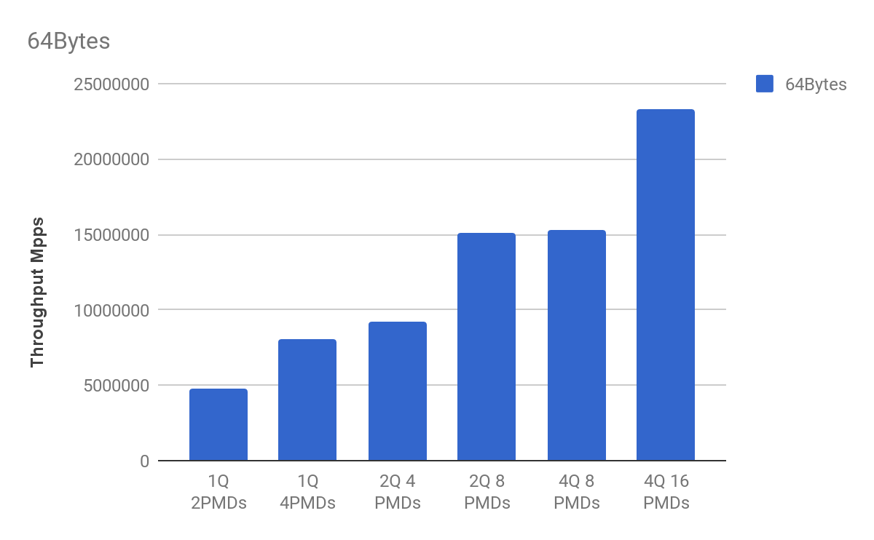
OVS-DPDK Multi-queue performance
OVS-DPDK Zero Loss Multi-queue
OpenFlow pipeline is not representative
OVS 2.7 and DPDK 16.11, RHEL 7.4, Intel 82599ES 10G NIC
Linear performance increase with multi-queue
VM (RHEL)
DPDK testpmd;
VFIO no-iommu
“L2 FWD”
Compute 1:
virtio
compute 2:
Tester; VSPerf test
Vhost-user
OVS-DPDK
(1 bridge, 4 OF rules)
Moongen
Traffic generator
 | 1Q 2 PMDs | 1Q 4PMDs | 2Q 4 PMDs | 2Q 8 PMDs | 4Q 8 PMDs | 4Q 16 PMDs
64Bytes | 4791550 | 8043502 | 9204914 | 15108820 | 15244256 | 23257998
Intel 82599
Intel 82599

Slide 34
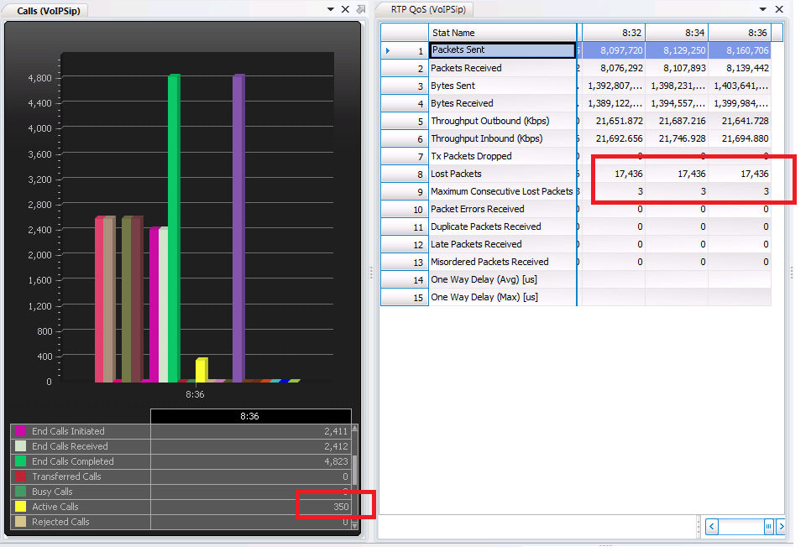
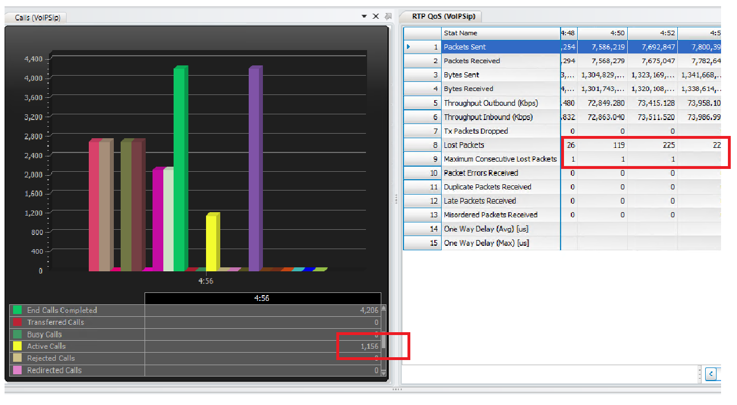
Performance Data
4vCPU Virtio
Instance
Without Performance Recommendations
With Performance Recommendations

Slide 35
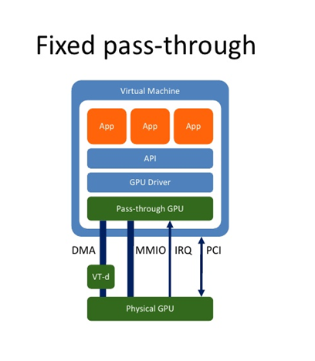
Accelerated devices: GPU for Audio Transcoding
Custom Hardware
Dedicated DSP Chipsets for Transcoding
Scaling is costly
CPU based transcoding for (almost) all the codecs
Less Number of concurrent audio streams
scaling difficult to meet commercial requirements
Hence, GPU Transcoding
Better Fit into cloud model than DSPs
Suitable for the Distributed SBC where GPU can be used by any COTS server or VM acting as a TSBC
GPU : Audio Transcoding - (POC stage)
Transcoding on GPU with Nvidia M60 with multiple Codecs
AMR-WB, EVRCB, G722, G729, G711,AMR-NB,EVRC
Work in Progress
Additional Codecs -- EVS,OPUS, others
Nvidia P100, V100 – next generation of Nvidia GPUs

Slide 36
Future/Roadmap Items
Configuring the txqueuelen of tap devices in case of OVS ML2 plugins:
https://blueprints.launchpad.net/neutron/+spec/txqueuelen-configuration-on-tap
Isolate Emulator threads to different cores than the vCPU pinned cores:
https://blueprints.launchpad.net/nova/+spec/libvirt-emulator-threads-policy
SR-IOV Trusted VF:
https://blueprints.launchpad.net/nova/+spec/sriov-trusted-vfs
Accelerated devices ( GPU/FPGA/QAT) & Smart NICs.
https://blueprints.launchpad.net/horizon/+spec/pci-stats-in-horizon
https://blueprints.launchpad.net/nova/+spec/pci-extra-info
SR-IOV Numa Awareness
https://blueprints.launchpad.net/nova/+spec/reserve-numa-with-pci

Slide 37
Q & A

Slide 38
Thank You

Slide 39
Backup

Slide 40
OPENSTACK TUNING TO ADDRESS CPU BOTTLENECKS
CPU Feature Request
Exposes CPU instruction set extensions to the Nova scheduler
Configure libvirt to expose the host CPU features to the guest
/etc/nova/nova.conf
[libvirt]
cpu_mode=host-model or host-passthrough virt_type=kvm
Enable ComputeFilter Nova scheduler filter
Remove CPU OverCommit.

Slide 41
OPENSTACK TUNING FOR CPU BOTTLENECKS …
Dedicated CPU policy considers thread affinity in the context of SMT enabled systems
The CPU Threads Policy will control how the scheduler places guests with respect to CPU threads.
hw:cpu_threads_policy=avoid|separate|isolate|prefer
hw:cpu_policy=shared|dedicated
Attach these policy to the flavor or image metadata of the Guest instance.
Assign cpus on the host to be used by Nova for the Guest CPU pinning
Osolate the cores to be used by Qemu for the instance, so that no host level processes can run on them.
Segragate realtime and non realtime workloads to different computes using host aggregates
/etc/nova/nova.conf
[DEFAULT]
vcpu_pin_set=x-y

Slide 42
OPENSTACK TUNING FOR CPU BOTTLENECKS …
CPU Topology of the Guest
With CPU pinning in place it will be always beneficial to have a proper view of the host topology to be configured in the guest too. It poses good benefit to have it proper so that the hypervisor overhead can be reduced.
hw:cpu_sockets=CPU-SOCKETS
hw:cpu_cores=CPU-CORES
hw:cpu_threads=CPU-THREADS
hw:cpu_max_sockets=MAX-CPU-SOCKETS
hw:cpu_max_cores=MAX-CPU-CORES
hw:cpu_max_threads=MAX-CPU-THREADS
This should be set in the metadata of the image or the flavor.

Slide 43
OPENSTACK TUNING TO ADDRESS MEMORY BOTTLENECKS …
Nova scheduler was extended with the NUMA topology filter
scheduler_default_filters = …. , NUMATopologyFilter
Specify guest NUMA topology using Nova flavor extra specs
hw:numa_nodes hw:numa_mempolicy=strict|preferred hw:numa_cpus.NN hw:numa_mem.NN
Attach these policy to the flavor or image metadata of the Guest instance.

Slide 44
OPENSTACK TUNING TO ADDRESS MEMORY BOTTLENECKS …
Host OS must be configured to define the huge page size and the number to be created
/etc/default/grub: GRUB_CMDLINE_LINUX="default_hugepagesz=1G hugepagesz=1G hugepages=60"
Libvirt configuration required to enable hugepages
/etc/libvirt/qemu.conf • hugetlbfs_mount = "/mnt/huge“
hw:mem_page_size=small|large|any|2048|1048576 Attach these policy to the flavor or image metadata of the Guest instance.
Remove memory overcommit

